Slide 1

Olga Tikhonenkova
Supermarket sales data analysis
Analysis of revenue, assortment and seasonality of supermarket
chain sales for making managerial decisions

Slide 2

Introduction:
The aim of the project is to analyze sales in different supermarket branches in order to
identify:
– the leathers and the outsiders
– the most profitable products
– seasonality
– points of the growth and the decrease in revenue
Target audience:
– Owner (see income structure)
– Director of the network (compare branches)
– Marketing specialist (understand, where to launch promotions)
– Financier (plan a budget)
– Store manager (improve the store's assortment)
link data: https://www.kaggle.com/datasets/hanif13/supermarket-sales
link code:https://colab.research.google.com/drive/1qaKIeEZEYzHI0z8c1DuNWgxSU2ZwMvfI?usp=sharing

Slide 3
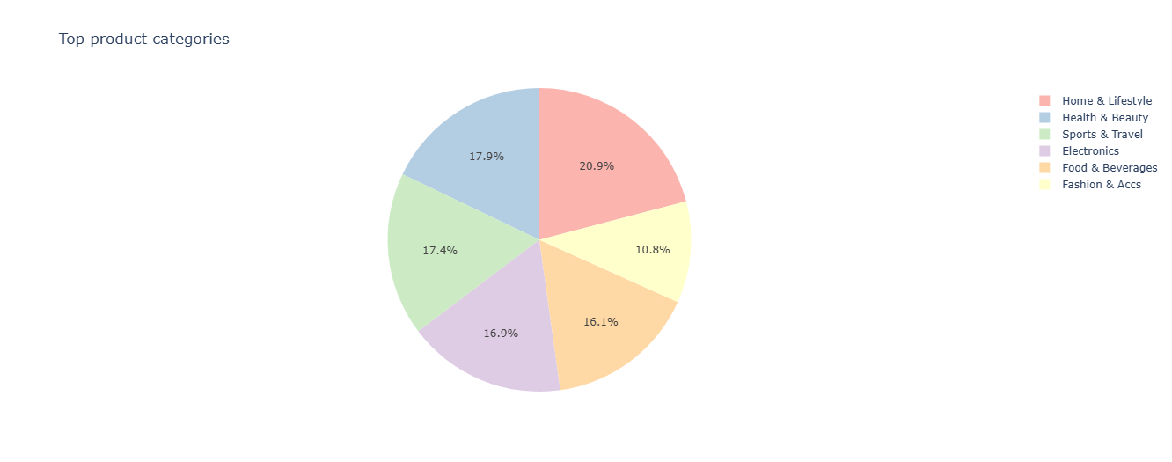
Top revenue by product lines :
As a result of the analysis of revenue across product lines, it can be seen that revenue across all lines is
not much different. The line "Home & lifestyle" is on the first place (its share is 20.9%).
The line "Fashion & Accs" is on the last place (10.8%).

Slide 4
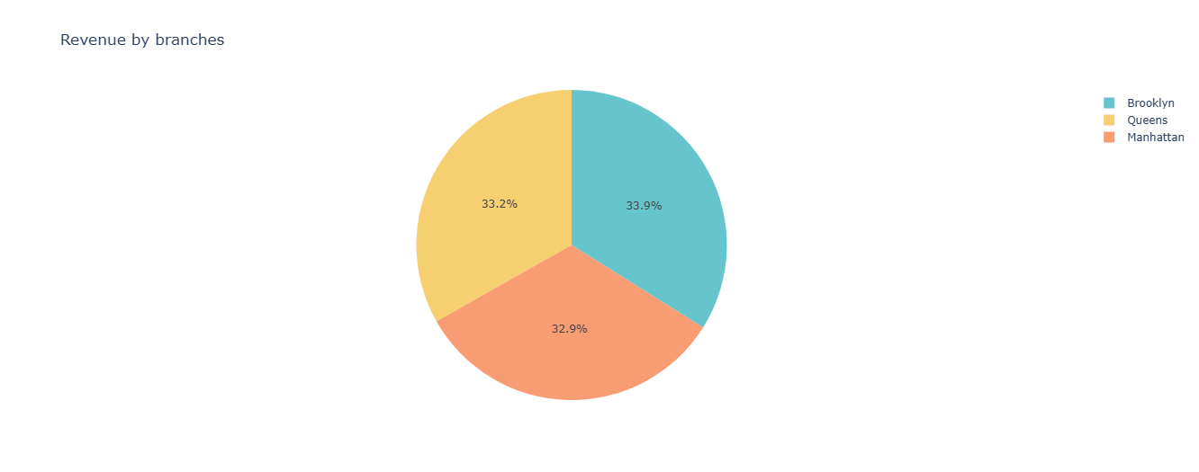
Revenue analysis by branches:
Revenue in all 3 branches is approximately the same, and all 3 branches are operating efficiently.

Slide 5
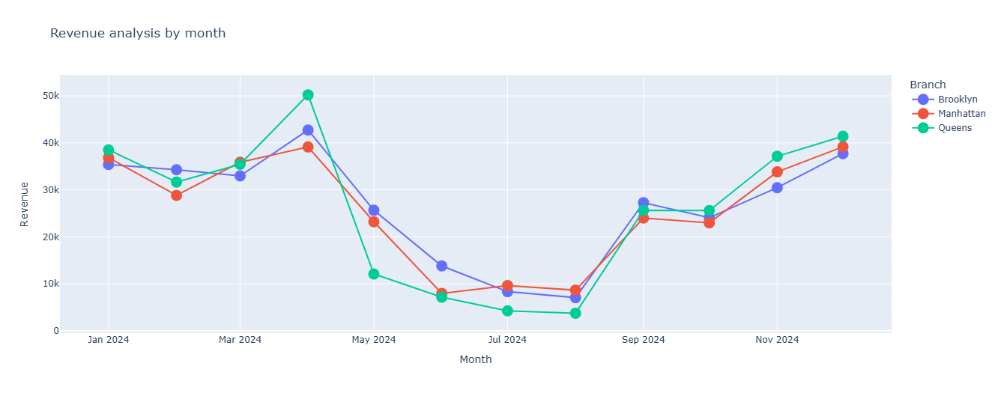
Revenue analysis by month :
An analysis shows a sharp drop in revenue from may to august. The drop in revenue is about the same in all branches.

Slide 6
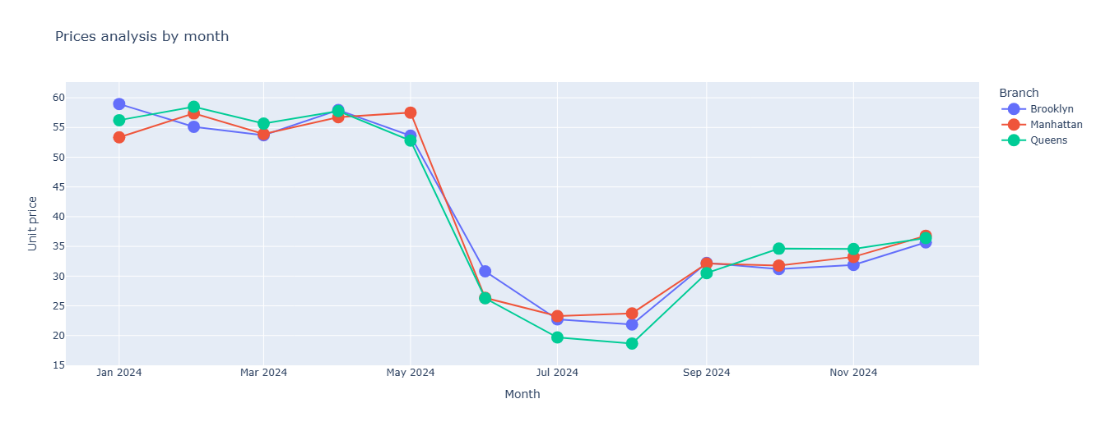
Prices analysis by month:
A monthly price analysis shows that one of the reason of the drop in revenue is directly related to lower prices.

Slide 7
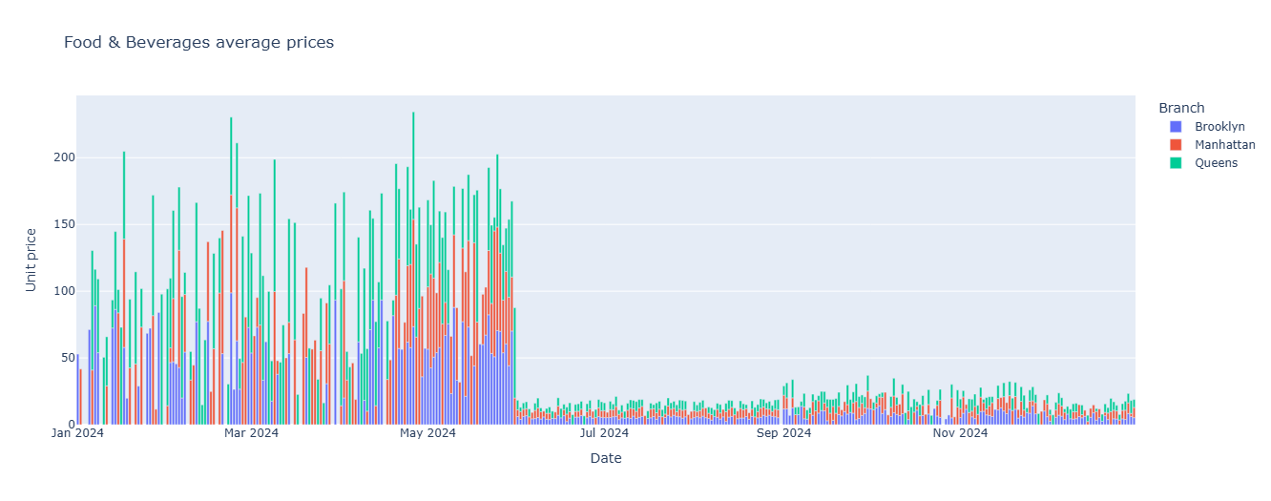
Food & Beverages average prices:
An analysis of the prices of product lines showed a sharp drop in prices starting in June.The reason for the price drop may be a change in the product range or a change in the company's trade policy .

Slide 8
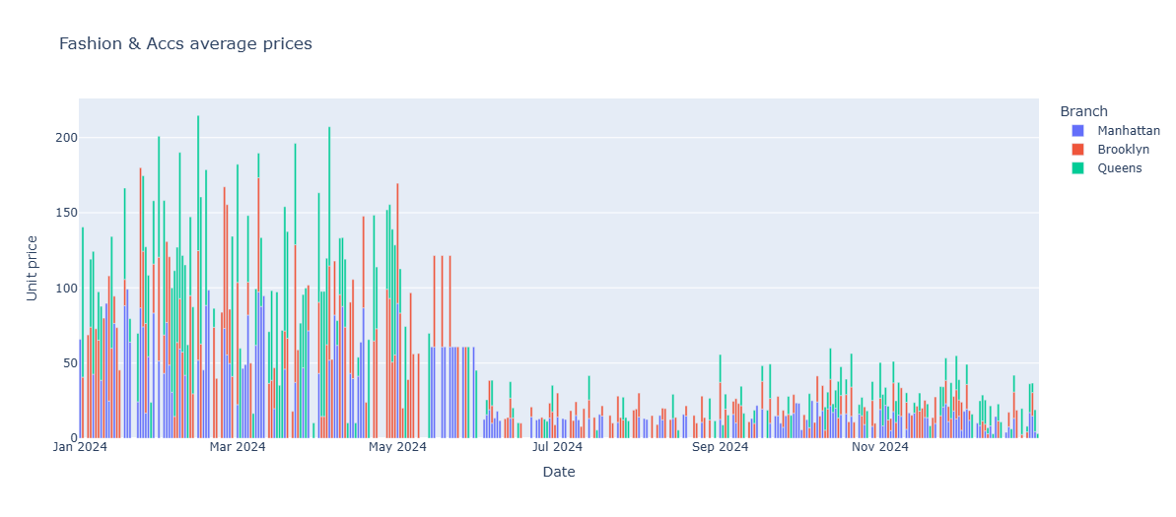
Fashion & Accs average prices:
The same situation applies to a product line "Fashion & Accs".

Slide 9
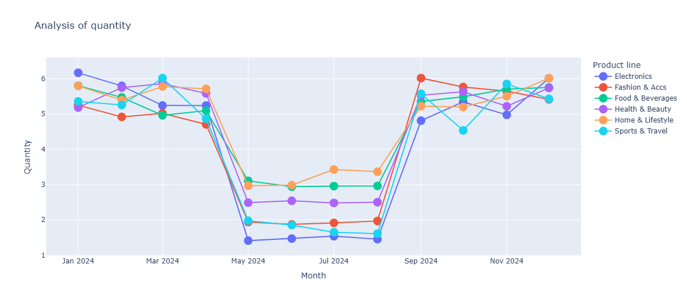
Monthly analysis of the number of products sold:
The picture shows a seasonal drop in demand for all product lines. This is another reason for the drop in revenue.

Slide 10
Conclusions:
– All 3 branches are operating stably and making good revenue;
– 4 product categories account for 73% of the revenue (Home & Lifestyle, Health & Beauty, Sports & Travel, Electronics);
– Revenue in 2 product categories is lower than in the rest due to the sharp decline in prices in the second half of 2024;
– There is also a decrease in revenue during the summer period.

